Slide 3
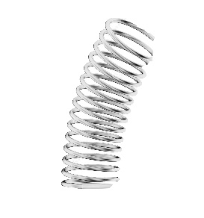

Slide 5
13
6
1
12
5
1
11
1
2
2
4
5
3
3
10
4
6
4
9
5
8
7
5
6
7
7
6

Slide 6
i
l

Slide 7
1
N_c + N_r
N_c

Slide 8

m
$$\vec{r_{mn}}$$
n

Slide 9
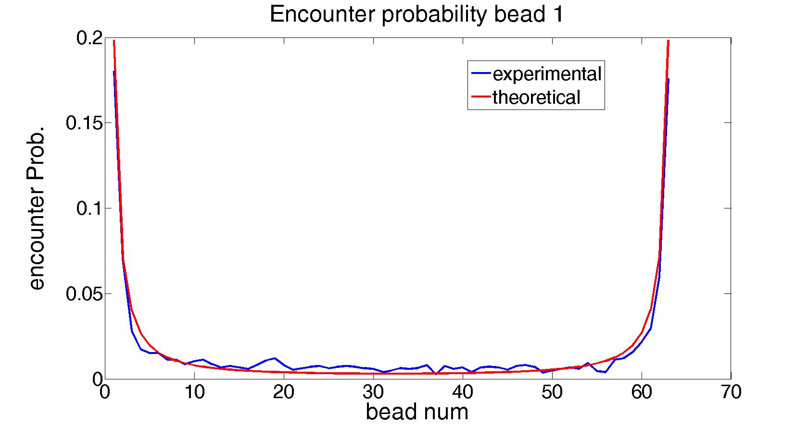
m
r1m
1

Slide 10





$${\vec{r}}_{N_{c}m}$$
$$Nc$$
$${\vec{r}}_{nN_{c}}$$
$$m$$
$$n$$

Slide 12
Encounter Prob. bead 1
D1
D1- chain encounter prob. D2- ring encounter Prob.
Encounter Prob.
D2
D1
D2
D1
Distance [bead]

Slide 13

m
$$\vec{r_{1m}}$$
1

Slide 14
P(n)
P(1)
Prob.
1
n
Distance [beads]

